Slide 1

Session 11
Exception handling

Slide 2
Objectives
Define and describe exceptions
Explain the process of throwing and catching exceptions
Explain nested try and multiple catch blocks
Define and describe custom exceptions

Slide 3
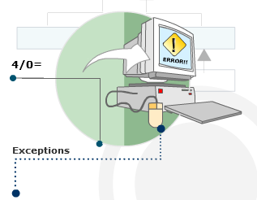
Purpose 1-2
Exceptions are abnormal events that prevent a certain task from being completed successfully.

Slide 4
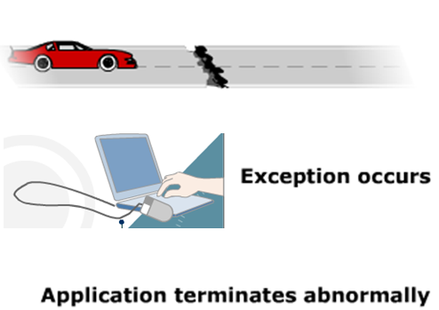
Purpose 2-2
Consider a vehicle that halts abruptly due to some problem in the engine.
Until this problem is sorted out, the vehicle may not move ahead.
Similarly, in C#, exceptions disrupt the normal flow of the program.
Example

Slide 5

Exceptions in C#
Consider a C# application that is currently being executed.
Assume that at some point of time, the CLR discovers that it does not have the read permission to read a particular file.
The CLR immediately stops further processing of the program and terminates its execution abruptly.
To avoid this from happening, you can use the exception handling features of C#.

Slide 6
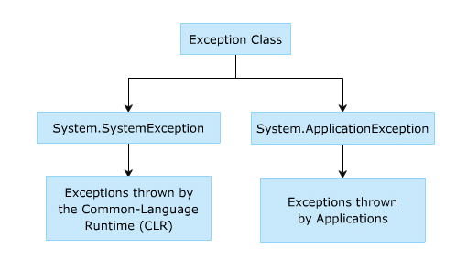
Types of Exceptions in C#
C# can handle different types of exceptions using exception handling statements.
It allows you to handle basically two kinds of exceptions. These are as follows:
System-level Exceptions: These are the exceptions thrown by the system that are thrown by the CLR.
For example, exceptions thrown due to failure in database connection or network connection are system-level exceptions.
Application-level Exceptions: These are thrown by user-created applications.
For example, exceptions thrown due to arithmetic operations or referencing any null object are application-level exceptions.
The following figure displays the types of exceptions in C#:

Slide 7
Properties of the Exception Class
System.Exception:
Is the base class that allows you to handle all exceptions in C#.
Is inherited by all exceptions in C# either directly or indirectly.
Contains public and protected methods that can be inherited by other exception classes and also contains properties that are common to all exceptions.
The following table describes the properties of Exception class:
Properties | Descriptions
Message | Displays a message which indicates the reason for the exception.
Source | Provides the name of the application or the object that caused the exception.
StackTrace | Provides exception details on the stack at the time the exception was thrown.
InnerException | Returns the Exception instance that caused the current exception.

Slide 8
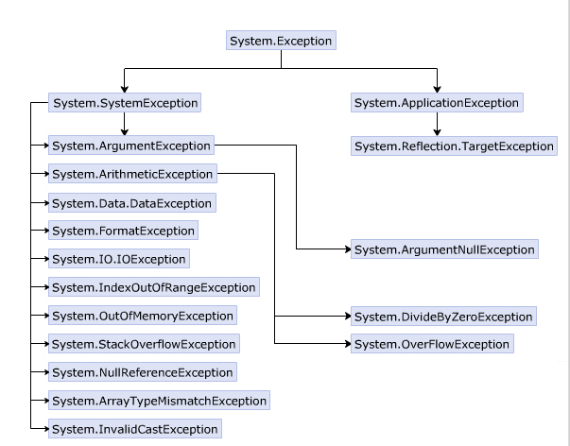
Commonly Used Exception Classes
The System.Exception class has a number of derived exception classes to handle different types of exceptions.
The hierarchy shown in the following figure displays the different exception classes in the System namespace:

Slide 9
Exception Classes 1-2
The System namespace contains the different exception classes that C# provides the type of exception to be handled depends on the specified exception class.
The following table lists some of the commonly used exception classes:
Exceptions | Descriptions
System.ArithmeticException | This exception is thrown for problems that occur due to arithmetic or casting and conversion operations.
System.ArgumentException | This exception is thrown when one of the arguments does not match the parameter specifications of the invoked method.
System.ArrayTypeMismatchException | This exception is thrown when an attempt is made to store data in an array whose type is incompatible with the type of the array.
System.DivideByZeroException | This exception is thrown when an attempt is made to divide a numeric value by zero.
System.IndexOutOfRangeException | This exception is thrown when an attempt is made to store data in an array using an index that is less than zero or outside the upper bound of the array.
System.InvalidCastException | This exception is thrown when an explicit conversion from the base type or interface type to another type fails.
System.ArgumentNullException | This exception is thrown when a null reference is passed to an argument of a method that does not accept null values.

Slide 10
Exception Classes 2-2
The following table lists additional exception classes:
Exceptions | Descriptions
System.NullReferenceException | This exception is thrown when you try to assign a value to a null object.
System.OutOfMemoryException | This exception is thrown when there is not enough memory to allocate to an object.
System.OverflowException | This exception is thrown when the result of an arithmetic, casting, or conversion operation is too large to be stored in the destination object or variable.
System.StackOverflowException | This exception is thrown when the stack runs out of space due to having too many pending method calls.
System.Data.DataException | This exception is thrown when errors are generated while using the ADO.NET components.
System.FormatException | This exception is thrown when the format of an argument does not match the format of the parameter data type of the invoked method.
System.IO.IOException | This exception is thrown when any I/O error occurs while accessing information using streams, files, and directories.

Slide 11
InvalidCastException Class 1-2
The InvalidCastException exception is thrown when an explicit conversion from a base type to another type fails.
The following code demonstrates the InvalidCastException exception:
using System;
class InvalidCastError
{
static void Main(string[] args)
{
try
{
float numOne = 3.14F;
Object obj = numOne;
int result = (int)obj;
Console.WriteLine("Value of numOne = {0}", result);
}
catch(InvalidCastException objEx)
{
Console.WriteLine("Message : {0}", objEx.Message);
Console.WriteLine("Error : {0}", objEx);
}
catch (Exception objEx)
{
Console.WriteLine("Error : {0}", objEx);
}
}
}
Snippet

Slide 12
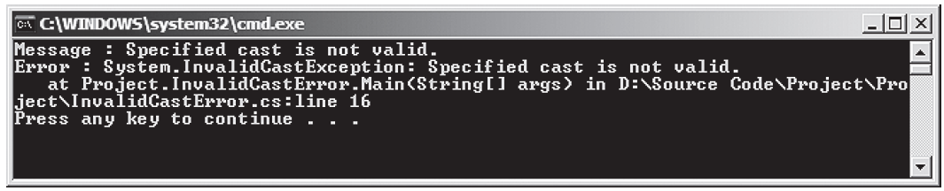
InvalidCastException Class 2-2
In the code:
A variable numOne is defined as float. When this variable is boxed, it is converted to type object.
However, when it is unboxed, it causes an InvalidCastException and displays a message for the same.
This is because a value of type float is unboxed to type int, which is not allowed in C#.
The figure displays the exception that is generated when the program is executed.

Slide 13
ArrayTypeMismatchException Class 1-2
The ArrayTypeMismatchException exception is thrown when the data type of the value being stored is incompatible with the data type of the array.
The following code demonstrates the ArrayTypeMismatchException exception:
using System;
class ArrayMisMatch
{
static void Main(string[] args)
{
string[] names = { "James", "Jack", "Peter" };
int[] id = { 10, 11, 12 };
double[] salary = { 1000, 2000, 3000 };
float[] bonus = new float[3];
try
{
salary.CopyTo(bonus, 0);
}
catch (ArrayTypeMismatchException objType)
{
Console.WriteLine("Error: " + objType);
}
catch (Exception objEx)
{
Console.WriteLine("Error: " + objEx);
}
}
}
Snippet

Slide 14
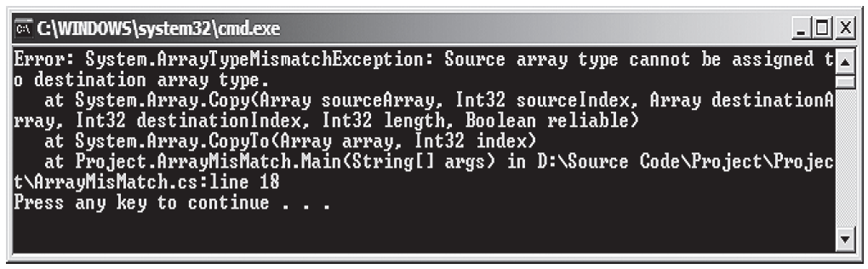
ArrayTypeMismatchException Class 2-2
In the code:
The salary array is of double data type and the bonus array is of float data type.
When copying the values stored in salary array to bonus array using the CopyTo() method, data type mismatch occurs.
The following table displays the exception that is generated when the program is executed:
Figure 11.4: ArrayTypeMismatchException Generated at Runtime

Slide 15
NullReferenceException Class 1-2
The NullReferenceException exception is thrown when an attempt is made to operate on a null reference as shown in the following code:
Snippet
using System;
class Employee
{
private string _empName;
private int _empID;
public Employee()
{
_empName = "David";
_empID = 101;
}
static void Main(string[] args)
{
Employee objEmployee = new Employee();
Employee objEmp = objEmployee;
objEmployee = null;
try
{
Console.WriteLine("Employee Name: " +
objEmployee._empName);
Console.WriteLine("Employee ID: " +
objEmployee._empID);
}
catch (NullReferenceException objNull)
{
Console.WriteLine("Error: " + objNull);
}
catch (Exception objEx)
{
Console.WriteLine("Error: " + objEx);
}
}
}

Slide 16
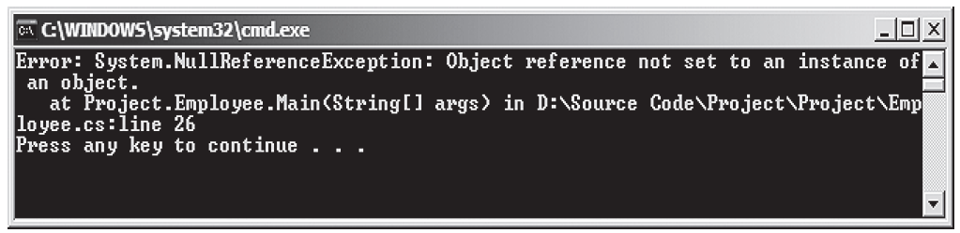
NullReferenceException Class 2-2
In the code:
A class Employee is defined which contains the details of an employee. Two instances of class Employee are created with the second instance referencing the first.
The first instance is de-referenced using null. If the first instance is used to print the values of the Employee class, a NullReferenceException exception is thrown, which is caught by the catch block.
The figure displays the exception that is generated when the program is executed.

Slide 17
System.Exception Class 1-5
System.Exception is the base class that handles all exceptions and contains public and protected methods that can be inherited by other exception classes.
The following table lists the public methods of the System.Exception class and their corresponding description:
Method | Description
Equals | Determines whether objects are equal
GetBaseException | Returns a type of Exception class when overridden in a derived class
GetHashCode | Returns a hash function for a particular type
GetObjectData | Stores information about serializing or deserializing a particular object with information about the exception when overridden in the inheriting class
GetType | Retrieves the type of the current instance
ToString | Returns a string representation of the thrown exception

Slide 18
System.Exception Class 2-5
The following code demonstrates some public methods of the System.Exception class:
Snippet
using System;
class ExceptionMethods
{
static void Main(string[] args)
{
byte numOne = 200;
byte numTwo = 5;
byte result = 0;
try
{
result = checked((byte)(numOne * numTwo));
Console.WriteLine("Result = {0}", result);
}
catch (Exception objEx)
{
Console.WriteLine("Error Description : {0}",
objEx.ToString());
Console.WriteLine("Exception : {0}", objEx.GetType());
}
}
}
In the code:
The arithmetic overflow occurs because the result of multiplication of two byte numbers exceeds the range of the data type of the destination variable, result.
The arithmetic overflow exception is thrown and it is caught by the catch block. The block uses the ToString() method to retrieve the string representation of the exception.
The GetType() method of the System.Exception class retrieves the type of exception which is then displayed by using the WriteLine() method.

Slide 19
System.Exception Class 3-5
The following table lists the protected methods of the class and their corresponding descriptions:
Name | Description
Finalize | Allows objects to perform cleanup operations before they are reclaimed by the garbage collector
MemberwiseClone | Creates a copy of the current object
In the following table lists the commonly used public properties in the class:
Public Property | Description
HelpLink | Retrieves or sets a link to the help file associated with the exception
InnerException | Retrieves the reference of the object of type Exception that caused the thrown exception
Message | Retrieves the description of the current exception
Source | Retrieves or sets the name of the application or the object that resulted in the error
StackTrace | Retrieves a string of the frames on the stack when an exception is thrown
TargetSite | Retrieves the method that throws the exception

Slide 20
System.Exception Class 4-5
The code demonstrates the use of some of the public properties of the System.Exception class.
using System;
class ExceptionProperties
{
static void Main(string[] args)
{
byte numOne = 200;
byte numTwo = 5;
byte result = 0;
try
{
result = checked((byte)(numOne * numTwo));
Console.WriteLine("Result = {0}", result);
}
catch (OverflowException objEx)
{
Console.WriteLine("Message : {0}",
objEx.Message);
Console.WriteLine("Source : {0}",
objEx.Source);
Console.WriteLine("TargetSite : {0}",
objEx.TargetSite);
Console.WriteLine("StackTrace : {0}",
objEx.StackTrace);
}
catch (Exception objEx)
{
Console.WriteLine("Error : {0}", objEx);
}
}
}
Snippet

Slide 21
System.Exception Class 5-5
In the code:
The arithmetic overflow occurs because the result of multiplication of two byte numbers exceeds the range of the destination variable type, result.
The arithmetic overflow exception is thrown and it is caught by the catch block.
The block uses various properties of the System.Exception class to display the source and target site of the error.
The following figure displays use of some of the public properties of the System.Exception class:

Slide 22
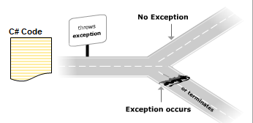
Throwing and Catching Exceptions
An exception is an error that occurs during program execution.
An exception arises when an operation cannot be completed normally. In such situations, the system throws an error.
The error is handled through the process of exception handling.

Slide 23
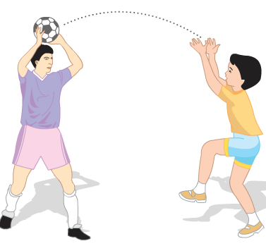
Purpose of Exception Handlers
Consider a group of boys playing throwball.
If any of the boys fail to catch the ball when thrown, the game is terminated.
Thus, the game goes on till the boys are successful in catching the ball on time.
Similarly, in C#, exceptions that occur while working on a particular program need to be caught by exception handlers.
If the program does not contain the appropriate exception handler, then the program might be terminated.
Example

Slide 24
Catching Exceptions 1-3
Exception handling is implemented using the try-catch construct in C# that consists of the following two blocks:
The try block
It encloses statements that might generate exceptions.
When these exceptions are thrown, the required actions are performed using the catch block.
The catch block
It consists of the appropriate error-handlers that handle exceptions.
If the catch block does not contain any parameter, it can catch any type of exception.
The catch block follows the try block and may or may not contain parameters.
If the catch block contains a parameter, it catches the type of exception specified by the parameter.

Slide 25
Catching Exceptions 2-3
The following syntax is used for handling errors using the try and catch blocks:
where,
try: Specifies that the block encloses statements that may throw exceptions.
program code: Are statements that may generate exceptions.
catch: Specifies that the block encloses statements that catch exceptions and carry out the appropriate actions.
ExceptionClass: Is the name of exception class. It is optional.
objException: Is an instance of the particular exception class. It can be omitted if the ExceptionClass is omitted.
Syntax
try
{
// program code
}
catch[(<ExceptionClass><objException>)]
{
// error handling code
}

Slide 26
Catching Exceptions 3-3
The code demonstrates the use of try-catch blocks.
In the code:
The Main() method of the class DivisionError declares three variables.
The try block contains the code to divide numOne by numTwo and store the output in the result variable. As numTwo has a value of zero, the try block throws an exception.
This exception is handled by the corresponding catch block, which takes in objDivide as the instance of the DivideByZeroException class.
The exception is caught by this catch block and the appropriate message is displayed as the output.
Exception caught: System.DivideByZeroException: Attempted to divide by zero. at DivisionError.Main(String[] args)
using System;
class DivisionError
{
static void Main(string[] args)
{
int numOne = 133;
int numTwo = 0;
int result;
try
{
result = numOne / numTwo;
}
catch (DivideByZeroException objDivide)
{
Console.WriteLine(“Exception caught: “ + objDivide);
}
}
}
Snippet
Output

Slide 27
General catch Block 1-2
Following are the features of a general catch block:
It can handle all types of exceptions.
However, the type of exception that the catch block handles depends on the specified exception class.
You can create a catch block with the base class Exception that are referred to as general catch blocks.
A general catch block can handle all types of exceptions.
However, one disadvantage of the general catch block is that there is no instance of the exception and thus, you cannot know what appropriate action must be performed for handling the exception.

Slide 28
General catch Block 2-2
The following code demonstrates the way in which a general catch block is declared:
In the code:
A string array called names is initialized. In the try block, there is a statement trying to reference a fourth array element.
The array can store only three values, so this will cause an exception. The class Students consists of a general catch block declared with Exception and this catch block can handle any type of exception.
Error: System.IndexOutOfRangeException: Index was outside the bounds of the array at
Project _New.Exception_Handling.Students.Main(String[] args) in D:\Exception Handling\Students.cs:line 17
Snippet
using System;
class Students
{
string[] _names = { “James”, “John”, “Alexander” };
static void Main(string[] args)
{
Students objStudents = new Students();
try
{
objStudents._names[4] = “Michael”;
}
catch (Exception objException)
{
Console.WriteLine(“Error: “ + objException);
}
}
}
Output

Slide 29
The throw Statement 1-3
The throw statement in C# allows you to programmatically throw exceptions using the throw keyword.
When you throw an exception using the throw keyword, the exception is handled by the catch block as shown in the following syntax:
where,
throw: Specifies that the exception is thrown programmatically.
exceptionObject: Is an instance of a particular exception class.
Syntax
throw exceptionObject;

Slide 30
The throw Statement 2-3
The following code demonstrates the use of the throw statement:
Snippet
using System;
class Employee
{
static void ThrowException(string name)
{
if (name == null)
{
throw new ArgumentNullException();
}
}
static void Main(string [] args)
{
Console.WriteLine(“Throw Example”);
try
{
string empName = null;
ThrowException(empName);
}
catch (ArgumentNullException objNull)
{
Console.WriteLine(“Exception caught: “ + objNull);
}
}
}
In the code:
The class Employee declares a static method called ThrowException that takes a string parameter called name.
If the value of name is null, the C# compiler throws the exception, which is caught by the instance of the ArgumentNullException class.
In the try block, the value of name is null and the control of the program goes back to the method ThrowException, where the exception is thrown for referencing a null value.
The catch block consists of the error handler, which is executed when the exception is thrown.

Slide 31
The throw Statement 3-3
Throw Example
Exception caught: System.ArgumentNullException: Value cannot be null.
at Exception_Handling.Employee.ThrowException(String name) in D:\Exception Handling\Employee.cs:
line 13
at Exception_Handling.Employee.Main(String[] args) in D:\Exception Handling\Employee.cs:line 24
Output

Slide 32
The finally Statement 1-2
In general, if any of the statements in the try block raises an exception, the catch block is executed and the rest of the statements in the try block are ignored.
Sometimes, it becomes mandatory to execute some statements irrespective of whether an exception is raised or not. In such cases, a finally block is used.
The finally block is an optional block and it appears after the catch block. It encloses statements that are executed regardless of whether an exception occurs.
The following syntax demonstrates the use of the finally block:
where,
finally: Specifies that the statements in the block have to be executed irrespective of whether or not an exception is raised.
Syntax
finally
{
// cleanup code;
}

Slide 33
The finally Statement 2-2
The following code demonstrates the use of the try-catch-finally construct:
In the code:
The Main() method of the class DivisionError declares and initializes two variables.
An attempt is made to divide one of the variables by zero and an exception is raised.
This exception is caught using the try-catch-finally construct.
The finally block is executed at the end even though an exception is thrown by the try block.
Exception caught: System.DivideByZeroException: Attempted to divide by zero.
at DivisionError.Main(String[] args)
This finally block will always be executed
using System;
class DivisionError
{
static void Main(string[] args)
{
int numOne = 133;
int numTwo = 0;
int result;
try
{
result = numOne / numTwo;
}
catch (DivideByZeroException objDivide)
{
Console.WriteLine(“Exception caught: “ + objDivide);
}
finally
{
Console.WriteLine(“This finally block will always be
executed”);
}
}
}
Snippet
Output

Slide 34
Performance 1-7
Exceptions hinder the performance of a program.
There are two design patterns that help in minimizing the hindrance caused due to exceptions. These are:
Tester-Doer Pattern:
A call that might throw exceptions is divided into two parts, tester and doer, using the tester-doer pattern.
The tester part will perform a test on the condition that might cause the doer part to throw an exception.
This test is then placed just before the code that throws an exception.

Slide 35
Performance 2-7
The following code demonstrates the use of the tester-doer pattern:
Snippet
using System;
class NumberDoer
{
public void Process(int numOne, int numTwo)
{
try
{
if (numTwo == 0)
{
throw new DivideByZeroException("Value of divisor is zero");
}
else
{
Console.WriteLine ("Quotient: " + (numOne / numTwo));
Console.WriteLine ("Remainder: " + (numOne % numTwo));
}
}
catch (DivideByZeroException objDivide)
{
Console.WriteLine("Error: " + objDivide);
}
}
}
class NumberTester
{
NumberDoer objDoer = new NumberDoer();
NumberDoer objDoer = new NumberDoer();
public void AcceptDetails()
{

Slide 36
Performance 3-7
int dividend = 0;
int divisor = 0;
Console.WriteLine("Enter the value of dividend");
try {
dividend = Convert.ToInt32(Console.ReadLine());
}
catch (FormatException objForm) {
Console.WriteLine("Error: " + objForm);
}
Console.WriteLine("Enter the value of divisor");
try {
divisor = Convert.ToInt32(Console.ReadLine());
}
catch (FormatException objFormat) {
Console.WriteLine("Error: " + objFormat);
}
if ((dividend > 0) || (divisor > 0))
{
objDoer.Process(dividend, divisor);
}
else
{
Console.WriteLine("Invalid input");
}
}
static void Main(string[] args)
{
NumberTester objTester = new NumberTester();
objTester.AcceptDetails();
}
}

Slide 37
Performance 4-7
In the code:
Two classes, NumberDoer and NumberTester, are defined. In the NumberTester class, if the value entered is not of int data type, an exception is thrown.
Next, a test is performed to check if either of the values of dividend and divisor is greater than 0. If the result is true, the values are passed to the Process() method of the NumberDoer class. In the NumberDoer class, another test is performed to check whether the value of the divisor is equal to 0.
If the condition is true, then the DivideByZero exception is thrown and caught by the catch block.
The following figure displays the use of tester-doer pattern:

Slide 38
Performance 5-7
TryParse Pattern
There are two different methods to implement the TryParse pattern. The first method is X, which performs the operation and throws the exception.
The second method is TryX, which also performs the operation but does not throw the exception.
Instead, it returns a boolean value that indicates whether the operation failed or succeeded.
The following code demonstrates the use of the TryParse pattern:
Snippet
using System;
class Product
{
private int _quantity;
private float _price;
private double _sales;
string _productName;
public Product()
{
_productName = "Motherboard";
}
public void AcceptDetails()
{
Console.WriteLine("Enter the number of " + _productName +
" sold");
try

Slide 39
Performance 6-7
{
_quantity = Int32.Parse(Console.ReadLine());
}
catch (FormatException objFormat)
{
Console.WriteLine("Error: " + objFormat);
return;
}
Console.WriteLine("Enter the price of the product");
if (float.TryParse((Console.ReadLine()), out _price) ==
true)
{
_sales = _price * _quantity;
}
else
{
Console.WriteLine("Invalid price inserted");
}
}
public void Display()
{
Console.WriteLine("Product Name: " + _productName);
Console.WriteLine("Product Price: " + _price);
Console.WriteLine("Quantity sold: " + _quantity);
Console.WriteLine("Total Sale Value: " + _sales);
}
static void Main(string[] args)
{
Product objGoods = new Product();
objGoods.AcceptDetails();
objGoods.Display();
}
}

Slide 40
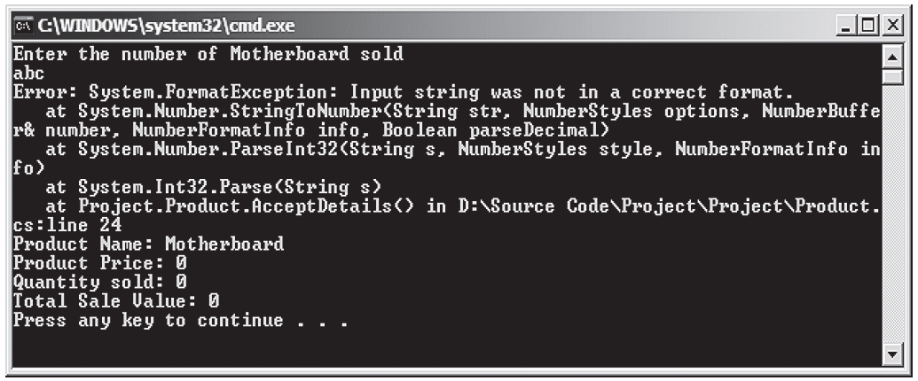
Performance 7-7
In the code:
A class Product is defined in which the total product sales is calculated.
The user-defined function AcceptDetails accepts the number of products sold and the price of each product. The number of products sold is converted to int data type using the Parse() method of the Int32 structure.
This method throws an exception if the value entered is not of the int data type. Hence, this method is included in the try...catch block.
When accepting the price of the product, the TryParse pattern is used to verify whether the value entered is of the correct data type.
If the value returned by the TryParse() method is true, the sale price is calculated.
The following figure displays the output of the code when the user enters a value which is not of int data type:

Slide 41
Nested try and Multiple catch Blocks
Exception handling code can be nested in a program. In nested exception handling, a try block can enclose another try-catch block.
In addition, a single try block can have multiple catch blocks that are sequenced to catch and handle different type of exceptions raised in the try block.

Slide 42
Nested try Blocks 1-4
Following are the features of the nested try block:
The nested try block consists of multiple try-catch constructs that starts with a try block, which is called the outer try block.
This outer try block contains multiple try blocks within it, which are called inner try blocks.
If an exception is thrown by a nested try block, the control passes to its corresponding nested catch block.
Consider an outer try block containing a nested try-catch-finally construct. If the inner try block throws an exception, control is passed to the inner catch block.
However, if the inner catch block does not contain the appropriate error handler, the control is passed to the outer catch block.

Slide 43
Nested try Blocks 2-4
The following syntax is used to create nested try…catch blocks:
Syntax
try
{
// outer try block
try
{
// inner try block
}
catch
{
// inner catch block
}
// this is optional
finally
{
// inner finally block
}
}
catch
{
// outer catch block
}
// this is optional
finally
{
// outer finally block
}

Slide 44
Nested try Blocks 3-4
The following code demonstrates the use of nested try blocks:
Snippet
static void Main(string[] args)
{
string[] names = {“John”, “James”};
int numOne = 0;
int result;
try
{
Console.WriteLine(“This is the outer try block”);
try
{
result = 133 / numOne;
}
catch (ArithmeticException objMaths)
{
Console.WriteLine(“Divide by 0 “ + objMaths);
}
names[2] = “Smith”;
}
catch (IndexOutOfRangeException objIndex)
{
Console.WriteLine(“Wrong number of arguments supplied ” + objIndex);
}
}

Slide 45
Nested try Blocks 4-4
In the code:
The array variable called names of type string is initialized to have two values.
The outer try block consists of another try-catch construct.
The inner try block divides two numbers. As an attempt is made to divide the number by zero, the inner try block throws an exception, which is handled by the inner catch block.
In addition, in the outer try block, there is a statement referencing a third array element whereas, the array can store only two values. So, the outer try block also throws an exception, which is handled by the outer catch block.
This is the outer try block
Divide by 0 System.DivideByZeroException: Attempted to divide by zero.
at Product.Main(String[] args) in c:\ConsoleApplication1\Program.cs:line 52
Wrong number of arguments supplied System.IndexOutOfRangeException: Index was outside the bounds of the array.
at Product.Main(String[] args) in c:\ConsoleApplication1\Program.cs:line 58
Output

Slide 46
Multiple catch Blocks 1-3
A try block can throw multiple types of exceptions, which need to be handled by the catch block. C# allows you to define multiple catch blocks to handle the different types of exceptions that might be raised by the try block. Depending on the type of exception thrown by the try block, the appropriate catch block (if present) is executed.
However, if the compiler does not find the appropriate catch block, then the general catch block is executed.
Once the catch block is executed, the program control is passed to the finally block (if any) and then the control terminates the try-catch-finally construct.
The following syntax is used for defining multiple catch blocks:
Syntax
try
{
// program code
}
catch (<ExceptionClass><objException>)
{
// statements for handling the exception
}
catch (<ExceptionClass1><objException>)
{
// statements for handling the exception
}
. . .

Slide 47
Multiple catch Blocks 2-3
The following code demonstrates the use of multiple catch blocks:
Snippet
static void Main(string[] args)
{
string[] names = { “John”, “James” };
int numOne = 10;
int result = 0;
int index = 0;
try
{
index = 3;
names[index] = “Smith”;
result = 130 / numOne;
}
catch (DivideByZeroException objDivide)
{
Console.WriteLine(“Divide by 0 “ + objDivide);
}
catch (IndexOutOfRangeException objIndex)
{
Console.WriteLine(“Wrong number of arguments supplied “
+ objIndex);
}
catch (Exception objException)
{
Console.WriteLine(“Error: “ + objException);
}
Console.WriteLine(result);
}

Slide 48
Multiple catch Blocks 3-3
In the code:
The array, names, is initialized to two element values and two integer variables are declared and initialized.
As there is a reference to a third array element, an exception of type IndexOutOfRangeException is thrown and the second catch block is executed.
Since the try block encounters an exception in the first statement, the next statement in the try block is not executed and the control terminates the try-catch construct.
So, the C# compiler prints the initialized value of the variable result and not the value obtained by dividing the two numbers.
However, if an exception occurs that cannot be caught using either of the two catch blocks, then the last catch block with the general Exception class will be executed.

Slide 49
System.TypeInitializationException Class 1-2
The System.TypeInitializationException class is used to handle exceptions that are thrown when an instance of a class attempts to invoke the static constructor of the class as shown in the following code:
Snippet
using System;
class TypeInitError
{
static TypeInitError()
{
throw new ApplicationException("This program throws
TypeInitializationException error.");
}
static void Main(string[] args)
{
try
{
TypeInitError objType = new TypeInitError();
}
catch (TypeInitializationException objEx)
{
Console.WriteLine("Error : {0}",objEx);
}
catch (Exception objEx)
{
Console.WriteLine("Error : {0}", objEx);
}
}
}

Slide 50
System.TypeInitializationException Class 2-2
In the code:
A static constructor TypeInitError is defined. Here, only the static constructor is defined and when the instance of the class, objType attempts to invoke the constructor, an exception is thrown.
This invocation of the static constructor is not allowed and the instance of the TypeInitializationException class is used to display the error message in the catch block.
The figure displays the System.TypeInitializationException generated at runtime:

Slide 51
Custom Exceptions
Following are the features of custom exceptions:
They are user-defined exceptions that allow users to recognize the cause of unexpected events in specific programs and display custom messages.
Allows you to simplify and improve the process of error-handling in a program.
Even though C# provides you with a rich set of exception classes, they do not address certain application-specific and system-specific constraints. To handle such constraints, you can define custom exceptions.
Custom exceptions can be created to handle exceptions that are thrown by the CLR as well as those that are thrown by user applications.

Slide 52
Implementing Custom Exceptions 1-2
Custom exceptions can be created by deriving from the Exception class, the SystemException class, or the ApplicationException class.
However, to define a custom exception, you first need to define a new class and then derive it from the Exception, SystemException, or ApplicationException class. Once you have created a custom exception, you can reuse it in any C# application.
The following demonstrates the implementation of custom exceptions:
Snippet
public class CustomMessage : Exception
{
public CustomMessage (string message) : base(message) {
}
}
public class CustomException{
static void Main(string[] args) {
try
{
throw new CustomMessage (“This illustrates creation and catching of custom exception”);
}
catch(CustomMessage objCustom)
{
Console.WriteLine(objCustom.Message);
}
}
}

Slide 53
Implementing Custom Exceptions 2-2
In the code:
The class CustomMessage is created, which is derived from the class Exception.
The constructor of the class CustomMessage is created and it takes a string parameter.
This constructor, in turn, calls the constructor of the base class, Exception. The class CustomException consists of the Main() method.
The try block of the class CustomException throws the custom exception that passes a string value.
The catch block catches the exception thrown by the try block and prints the message.
This illustrates creation and catching of custom exception
Output

Slide 54
Exception Assistant
Exception assistant is a new feature for debugging C# applications. The Exception dialog box feature in earlier versions of C# is replaced by Exception assistant.
This assistant appears whenever a run-time exception occurs.
It shows the type of exception that occurred, the troubleshooting tips, and the corrective action to be taken, and can also be used to view the details of an exception object.
Exception assistant provides more information about an exception than the Exception dialog box.
The assistant makes it easier to locate the cause of the exception and to solve the problem.

Slide 55
Summary
Exceptions are errors that encountered at run-time.
Exception-handling allows you to handle methods that are expected to generate exceptions.
The try block should enclose statements that may generate exceptions while the catch block should catch these exceptions.
The finally block is meant to enclose statements that need to be executed irrespective of whether or not an exception is thrown by the try block.
Nested try blocks allow you to have a try-catch-finally construct within a try block.
Multiple catch blocks can be implemented when a try block throws multiple types of exceptions.
Custom exceptions are user-defined exceptions that allow users to handle system and application-specific runtime errors.

Slide 56

THANKS FOR WATCHING !

